Slide 1

Module 3.4
Variables

Slide 2
Variables
Notes:
This page intentionally blank

Slide 3
Variables
A Variable is a Memory entity of the type BOOL, WORD, DWORD, etc., whose contents can be modified by the program during execution.
A Located Variable is a variable that is either mapped to an I/O Module or is associated to a Memory reference.
For example, the variable Water_pressure is associated with Memory Word %MW102. Water_pressure is said to be a Located Variable.
An Unlocated Variable is a variable which is not mapped to the I/O or associated to a Memory reference (not possible to know its position in memory). A variable which has no address assigned is said to be unlocated.

Slide 4
Variables (cont)
A Public Variable is a variable available with some Function Blocks. These variables transfer values to the function block. They are used for setting parameters of the function block.
A Private Variable is a variable use by some Function Blocks. These variables are not accessible by the application program.
I/ODDT is the abbreviation of Input/Output Derived Data Type. The term I/ODDT designates a structured data type representing a channel of a PLC module. Each expert module possesses its own I/ODDTs.
Constants is an INT, DINT or REAL type variable located in the constant field (%K), or variables used in direct addressing (%KW, %KD, or %KF). The contents of these cannot be modified by the program during execution.

Slide 5
Variables (cont)
Each Variable has to be declared with the Variable Data Editor before using it:
Either independently by double clicking in the Variables & FB Instances area of the Structural View tree...
Or during programming with a double-click on an input / output assignment.
A data type must be assigned to each Variable.
Unity Pro software provides elementary and derived data types.

Slide 6
Common Data Types and Ranges
BOOL/EBOOL : Boolean variable must be FALSE (0) or TRUE (1). EBOOL manage also forcing and edge detection
WORD : Represents a “bit string 16”, meaning the length of data is 16 bits
INT : Represents an integer value. The range of values are -32768 through 32767
UINT : Represents an unsigned integer value. The range of values are 0 through 65535
REAL : Represents a floating point value. The range of values are -3.40e+38 to 3.40e+38

Slide 7
Entering Literal Values
Literal values are used to assign values to pins, or to assign constants to variables, and are not meant to be changed by the program.
You can enter literal values as
  Base 2 (binary) 2#1111111111111111
  base 8 (octal) 8#177777
  base 10 (decimal) 65535 (no 10# needed)
  base 16 ( hex) 16#FFFF
All of the above values are equal, they were just entered differently

Slide 8
Variable Names
Max. length 32 characters, may start with number
Unlocated
Tag name without a hardware address
Unlocated variable cannot be set cyclically. Il you need to set variable cyclically in your project use located variables
Located
Tag name with a hardware address (State RAM)
Constants
Write protected variables
Use to assign a fix value to a variable

Slide 9
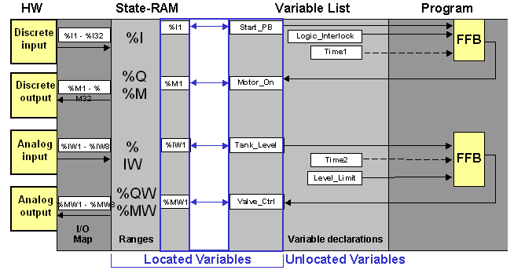
Configuration, Addressing and Variable Assignments

Slide 10
Direct Addressing
Every direct address has a reference that indicates its position in the sequence and whether it is an input address (read only) or an output address (read / write).
  0x / %Mx area = bit outputs (discrete) - example 1: 000001 is discrete Output 1 - example 2: %MX00001 is Output Bit 1
  1x / %IXx area = bit inputs (discrete) - example 1: 100017 is discrete Input 17 - example 2: %IX00017 is Input Bit 17
  3x / %IWx area = register inputs, - example 1: 300300 is register input 300
  - example 2: %IW000300 is Input Word 300
  4x / %MWx area = register outputs, - example 1: 400029 is register output 29 - example 2: %MW00029 is Output Word 29

Slide 11
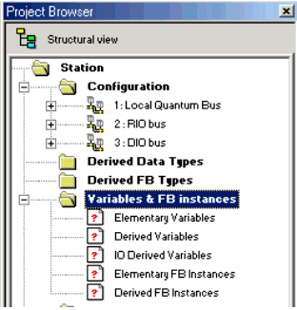
Variables and FB Instances Directory
To access the variables (elementary and derived)
and the function block instances
Notes:
Variables Directory:
The Variables and FB instances directory of the structured view of the project allows you to access the variables (EDT, DDT, IODDT) and the function block instances (EFB, DFB).
The illustration above shows an example of a directory tree of the Variables and FB instances directory .
Accessible Utilities
The Variables and FB instances directory allows you access to the following utilities, which can be reached via the context-sensitive menu:

Slide 12
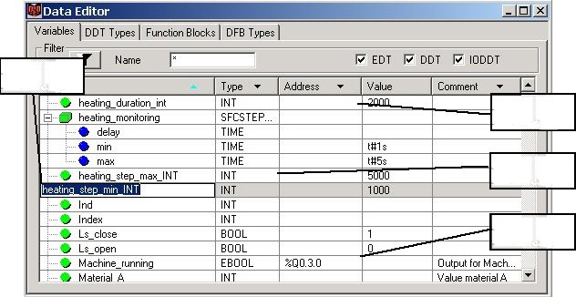
Editing Variables
Types definition and instances declaration in ONE TOOL
3
Identifier
2
Unlocated variables
Double-click on
cells to enter in
edit mode
Data Type
1
Located variable
Notes:
Types definition and instances declaration in ONE TOOL
Copy/Cut/Paste functionality
Search variable
Hyperlink on the comment of any variable
Columns customization
Display of all data properties in a specific window
Contract/Expand structured data (1)
Sorting by type, symbol, address... (2)
Filtering (3)
Select type from a list or from the variable type selection
Drag-drop facilities between editors and outside Unity Pro
UNDO feature on one level (last modification)
Import/export
Concerning Variables:
Promote the symbol usage
Symbolize all simple or structured objects
Associated topological mapping and/or initial value
I/O variable automatic symbolization

Slide 13
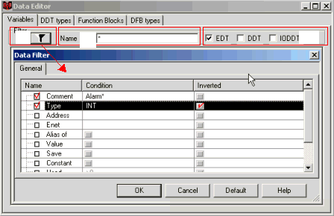
Filtering
Direct filtering on general type (EDT, ...) or variable names
Funnel filter using variable properties (Type, Comment, Address,...)
1
2
3
Notes:
(1) Funnel filter allows versatile displays of a part of the variables
database.
The name of the column to be filtered can be selected and a
condition must be given, the condition can be inverted by a check
box.
In the upper example, the filter will display All the variables including
Alarm in the beginning of the comment and the type is different from
INT.
(2) The name of the variable can be directly filtered.
Jokers, like ? (any character) or *(all characters) can replace
characters
(3) Direct filtering on the general type of the variable is also possible by
checking boxes EDT, DDT or IODDT.

Slide 14
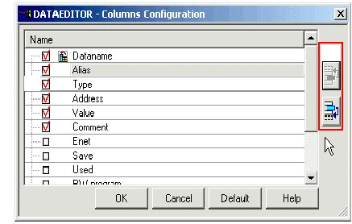
Configure the columns to display
Configure the columns to display
  Column configuration (customization) displays the variable parameters as the user wants.
        Columns can be moved by the
        upper right buttons
      A check in front of the name
      allows to you display the column
.
1
1
2
2

Slide 15
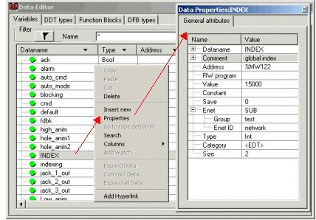
Data Properties (cont)
Even if the columns are not displayed, all the parameters of a variable can be shown in the Data Properties window.

Slide 16
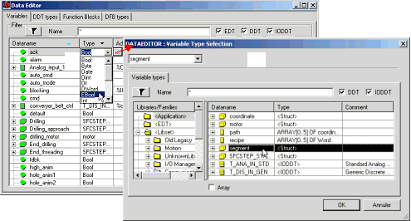
Edit Data Type
The type of data can be selected from a list of previously used types
or directly from the Variable type selection by clicking on […] button
1
2
1
2

Slide 17
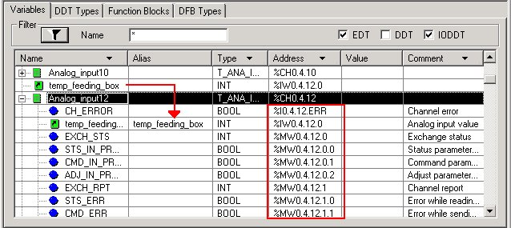
IODDT
To map a complete I/O structure from a module channel to one variable name
5
2
1
3
4
Notes:
The specific type IODDT allows you to map a complete I/O structure (1) from a module channel (2) directly with one data name (3).
(It is platform dependant)
Automatically the structure is mapped to the input/output bits and
words (4).
An Alias (5) can be used to give a user name to a particular structure variable.
IODDT allows you to program without a physical address, that simplifies the creation of standard modules, mapping can be done after the import.

Slide 18
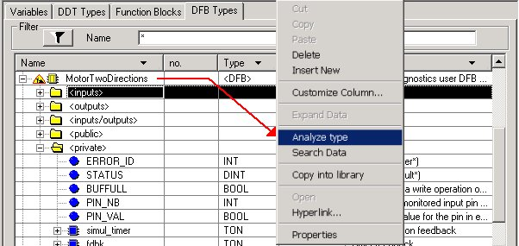
Editing Derived Function Blocks (DFB)
To define a user function block type
4
1
2
3 - DFB Sections
Notes:
Function Blocks Types (DFB):
(1) Creation of all DFB variable types: in, out, in / out, private, public
(2) Nested DFBs
(3) Creation of the DFB program: sections in LD, FBD, IL and ST.
Multiple sections are possible in one DFB
(4) Analyze and code generation, a little icon informs you that the DFB
is under work.
(5) Versioning and Library management

Slide 19

Editing Function Blocks (EFB, DFB)
To use a function block instance
1
2
Notes:
Function Blocks (EFB, DFB):
Symbolize and display Function Blocks instances in customer Application
The symbolization of function blocks can be done during the
programming directly in the program editor.
.

Slide 20
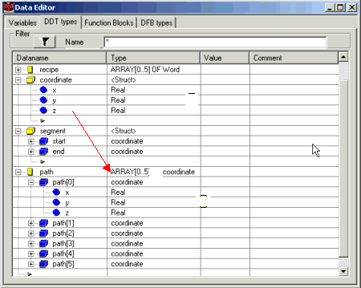
Derived Data Type
To define an array or structure type
1
2
3
Notes:
A derived data type is a definition of a structure of any predefined type (EDT, DDT).
They can be nested (up to eight levels), including arrays (up to 6 dimensions) of elementary data types (1) or derived data types (3).

Slide 21
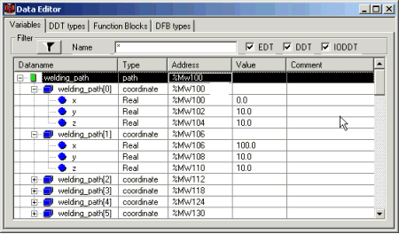
Variables Types (DDT)
To use an array or structure instance
4
Notes:
1 Structure or array definition
2 Nested structures
DDTs can be used as any elementary data type to define an instance of a variable. They can be mapped on physical memory if needed (4).

Slide 22
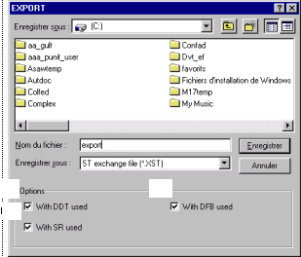
Export Functions
Options allows you to export a whole
section with all used:
  Derived Data Types (DDT)
  Derived Function Block (DFB)
  Sub routines
1
2
3
1
2
3
Notes:
Unity Pro offers a large possibility of export and import files. The files format used for the export/import functions is the XML standard, that allows you to create or use the export files easily from third party tools.
The export files of the following modules are possible :
Complete application, including configuration.
Sections in all languages (LD, ST, IL, FBD, SFC)
Derived Function Blocks (DFB)
Derived Data Type (DDT)
Variables
Operator Screens
Configuration in FNES format

Slide 23
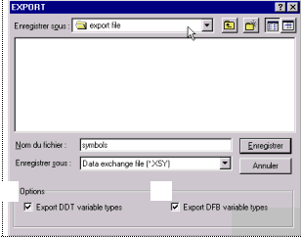
Export Functions (cont)
Instances of DDT or DFB can be exported with the associated types for a reusing in
the new program
  Derived Data Types (DDT)
  Derived Function Block (DFB)
1
2
1
2

Slide 24
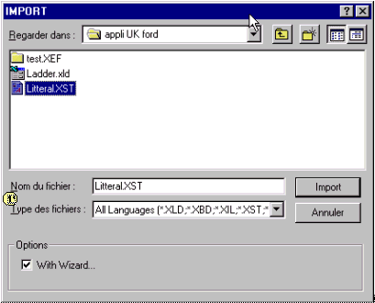
Import Functions
Use the wizard to change the naming of variables, section, ... or the mapping addresses
  The import is provided for all or a part of the application.
Two import modes are provided with Unity Pro :
  Direct import, import the module just like it was exported.
  Import with the wizard (1), to modify the naming of Variables,
  Sections or Functional Module, and changing the mapping
  addresses.

Slide 25
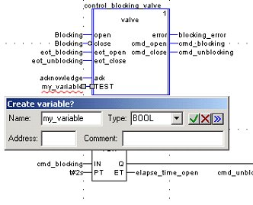
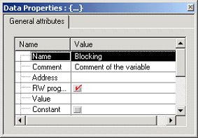
Editing in program
A variable can be created directly from any editor :
  When a string is entered, the smart analyzer check the availability
  A pop-up proposes to create the variable if it doesn’t exist
Data property window to display and modify object attributes inside the editors
  The window is updated on the selection

Slide 26
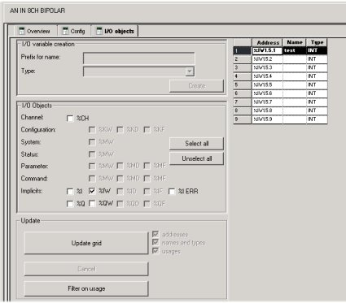
I/O Objects
New service available in the hardware configuration
Select and display all the objects managed by a module or CPU
Create IODDT or topological EDT variable(s) in one click
Presymbolize a set of IODDT variables or topological EDT variables
Display the I/O objects used by the application
Notes:
The following table summarizes the different functionalities according to the type of device associated with the tab:

Slide 27
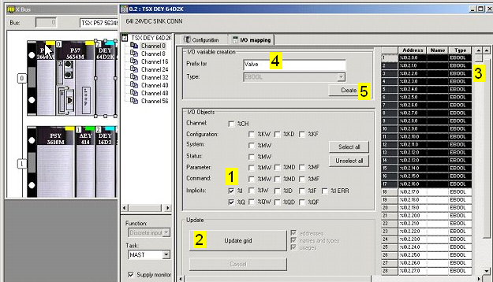
I/O Objects Editing
Select the kind of object
Update the grid
Select some of them
Define a prefix
Create the variables
1
2
3
4
5

Slide 28
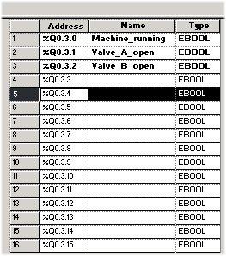
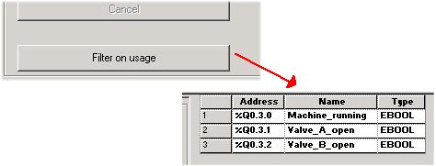
I/O Objects Ergonomics
I/O objects mapped on variables or used in the program are in bold
Possible to focus on the variable used only :click on Filter on usage button

